Slide 1
dataderby
ARCHITECTURE PITCH · OCT 2026
A football data pipeline that remembers every state the source reported.

Slide 2
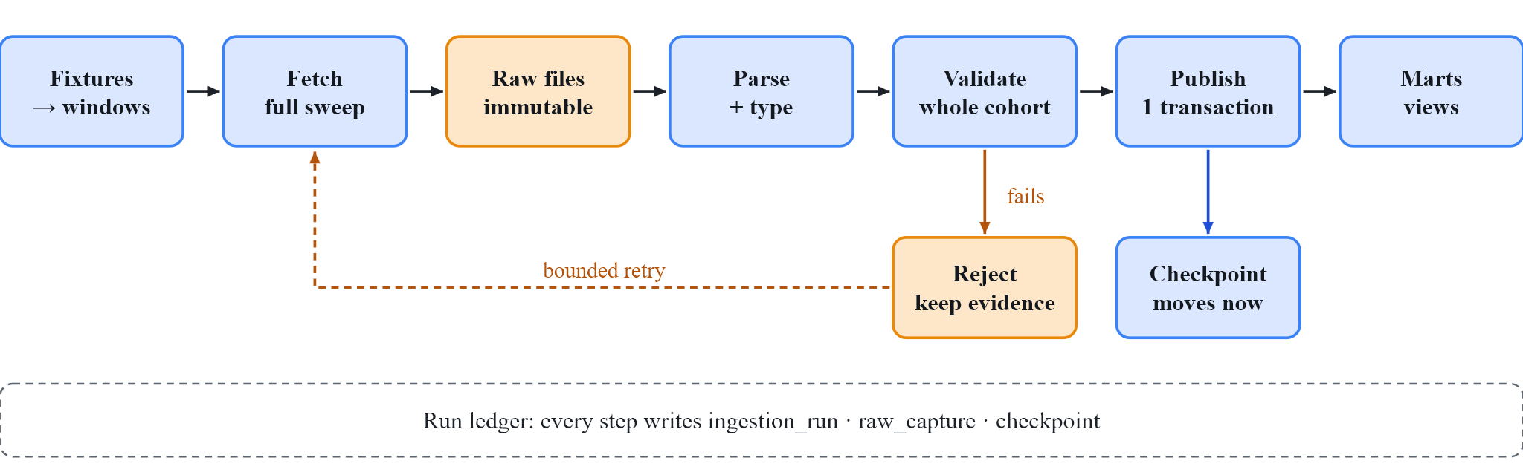
How data flows, step by step
“Checked, nothing new” is a success. “Fetch failed” is not. The ledger keeps them apart.
dataderby · architecture · 2/7

Slide 3
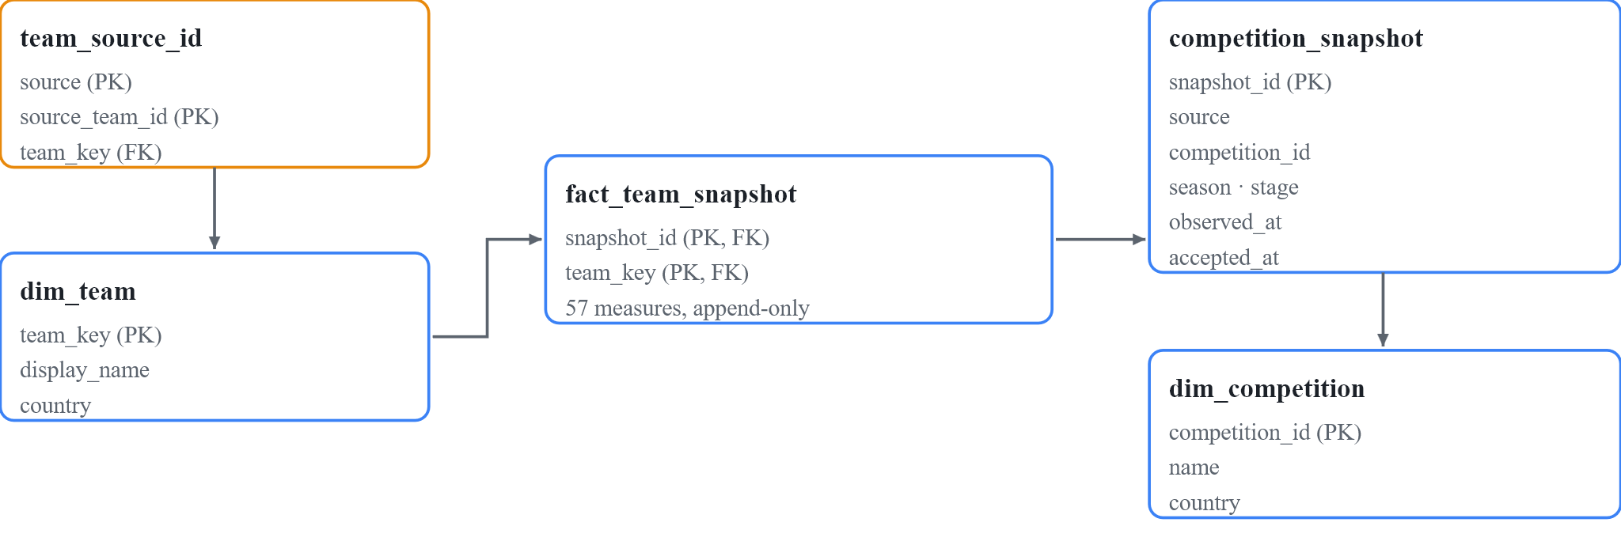
The data model: two clocks, five tables
One fact row = one team at one accepted snapshot. The competition sits on the snapshot, so one team can appear in many competitions.
dataderby · architecture · 3/7

Slide 4
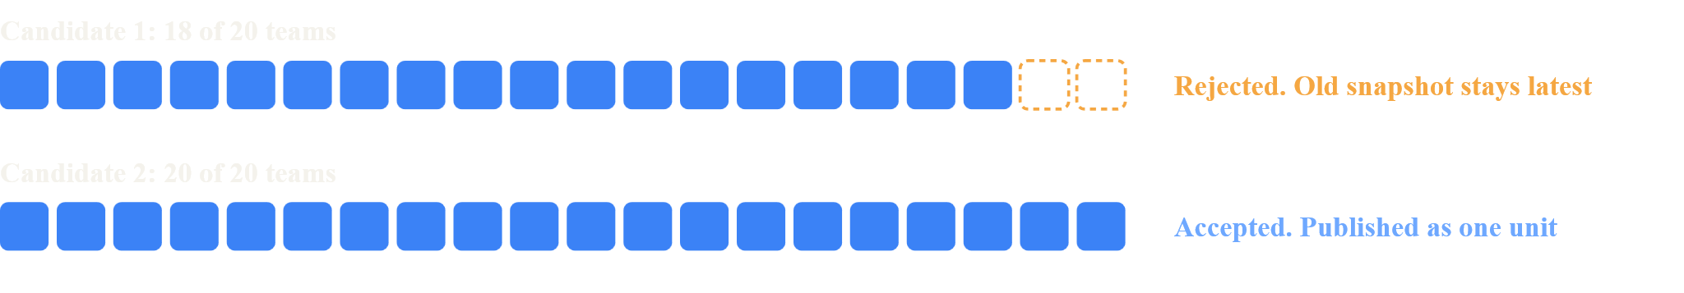
Publish all 20 teams, or nothing
Identity
Completeness
Schema
Consistency
No duplicate team in a snapshot
All expected teams, all sections
Fields and types as expected
Home + away = overall. Warn, then retry
dataderby · architecture · 4/7

Slide 5
Edge cases and what the pipeline does
What goes wrong | What we do
Table changes, detail fetch fails | Keep old checkpoint. Retry.
18 of 20 teams returned | Reject. Old snapshot stays latest.
Source is late | Log “source late”. Bounded retries.
Same run retried twice | Two raw files, one snapshot.
Provider adds or drops a field | Fail on drift. Raw file kept.
Value missing in payload | Store NULL. Never zero.
Two matches end together | One window, one run.
Wrong season label | Check ids against the request URL.
dataderby · architecture · 5/7

Slide 6
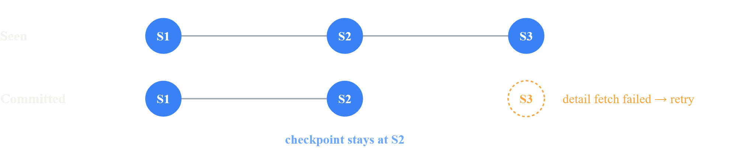
Safeguards: the checkpoint only moves on success
Back up raw files
Check the licence
Prove the skip rule
Version the parser
The site cannot be replayed. Copy raw JSON off this machine.
Read the source terms before any client use.
Does an unchanged table mean unchanged details? Measure it.
Fingerprint the logic so a fix triggers a rebuild.
dataderby · architecture · 6/7

Slide 7
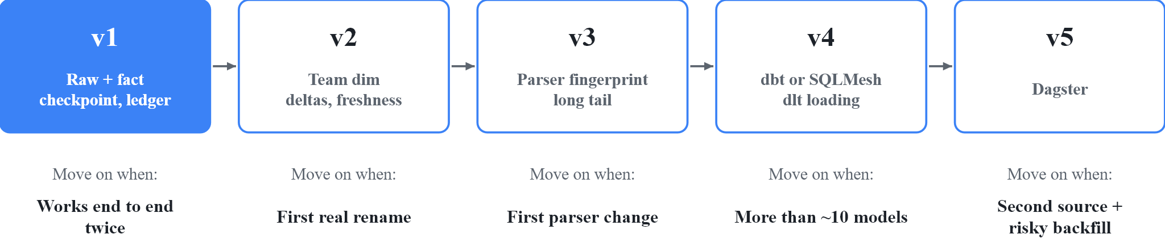
Build small, then grow on triggers
v1 gate: scrape one competition twice. The second run finds “no change”. A failed fetch retries. Every snapshot has all teams.
Multi-source ready from day one: team_source_id maps each source id to one team_key.
dataderby · architecture · 7/7

